Slide 1
Duplicate Question Pairs
Usman Nisar
POLS8500

Slide 2
Outline
Introduction
Dataset
Approaches
String Matching
Ensemble Methods
Neural Network
Results
Conclusion

Slide 3
Problem
Quora – Popular platform for questions and answers
A lot of duplicate questions
Challenge: Identify duplicate questions
Currently:
Quora uses Random Forest model to identify duplicate questions
Kaggle Challenge - Ends in 2 months

Slide 4
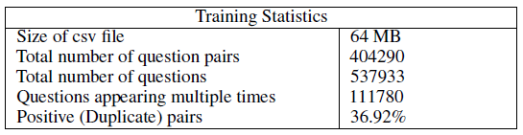
Dataset
CSV files
id - the id of a training set question pair
qid1, qid2 - unique ids of each question (only available in train.csv)
question1, question2 - the full text of each question
is_duplicate - the target variable, set to 1 if question1 and question2 have essentially the same meaning, and 0 otherwise.

Slide 5



String matching
Similarity techniques
Cosine
Jaccard
Sorenson-Dice

Slide 6
String matching … cont’d
Pros:
Very quick
No need for training
Cons:
No learning from the data
Not as accurate
Results:
Between 62-66%

Slide 7
Ensemble Techniques
Decision Tree based
Random Forest
Gradient Boosting
XGBoost

Slide 8
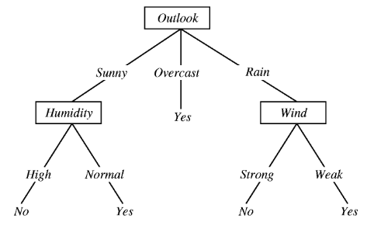
Decision Trees
Strengths:
Non linear
Robust to correlated features
Robust to feature distributions
Techniques for missing values
Interpretability
Fast
Weaknesses
Poor accuracy
Play Tennis

Slide 9
Ensemble techniques
Random Forest
Gradient Boosting

Slide 10
Random Forest
Combine multiple decision trees, each fit to a random sample of the original data
Trees are independent
Weigh the output of individual trees in some way for the final answer
Strengths
Easy to use
Competitive accuracy over plain decision trees
Weaknesses
Relatively slow to score

Slide 11
Gradient Boosting
Fits consecutive trees where each solves for the net loss of the prior trees
Results of new trees are applied partially to the entire solution
Strengths:
Often beats Random Forest
Weaknesses:
Tends to overfit
XGBoost
Avoids overfitting
Scalable

Slide 12
Gradient Boosting vs Random Forest
Random Forest: 75%
XGBoost: 83%

Slide 13
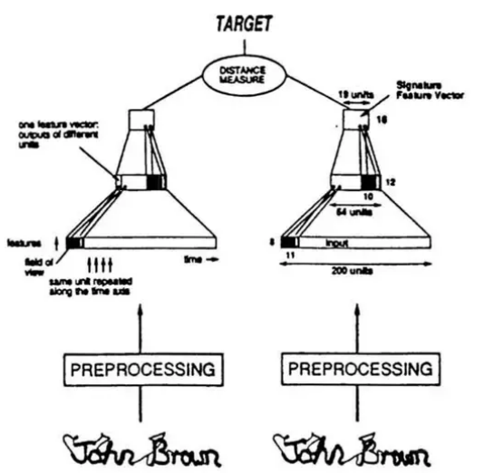
Neural networks
Siamese Neural Networks
One subnetwork for each input
Combine the results using a distance measure

Slide 14
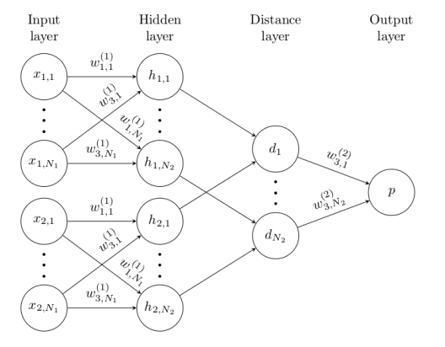
Results:
Parameter tuning
Accuracy: 70%

Slide 15
Conclusion
Results Accuracy:
String Matching: 62-66%
Ensemble:
Random Forest: 75%
Gradient Boosting: 83%
Neural Networks:
Siamese Network: 70%

Slide 16
Thanks

